Slide 1
R-Programming September 9, 2017
Vivek Singh
Information Systems Decision Sciences (ISDS)
MUMA College Of Business
vivek4@mail.usf.edu
Web: http://vivek4.myweb.usf.edu

Slide 2









About Me
Professional Experience
Technologies
Teaching @ USF
Sprint 2017
ISM 4930: Applied Data Science (Cloud computing and Real-time Business)
1st R Bootcamp [January 27, 2017]
2nd R Bootcamp [February 17, 2017]
Fall 2017
ISM 3113: System Analysis Design
1st Python Bootcamp [August 11 – 16, 2017]
3rd R Bootcamp [August 18, 2017]

Slide 3
Outline
Motivation – Why R?
Programming IDE – R studio, workspace, Console
Programming – objects, loops, conditionals, function
File Input/output
R- Packages
Data manipulation
Database connector – MySQL
Visualization
Datasets
Social Media APIs – Twitter, Facebook, Google Trends, YouTube
CIRCE @USF (Cluster Computing)

Slide 4


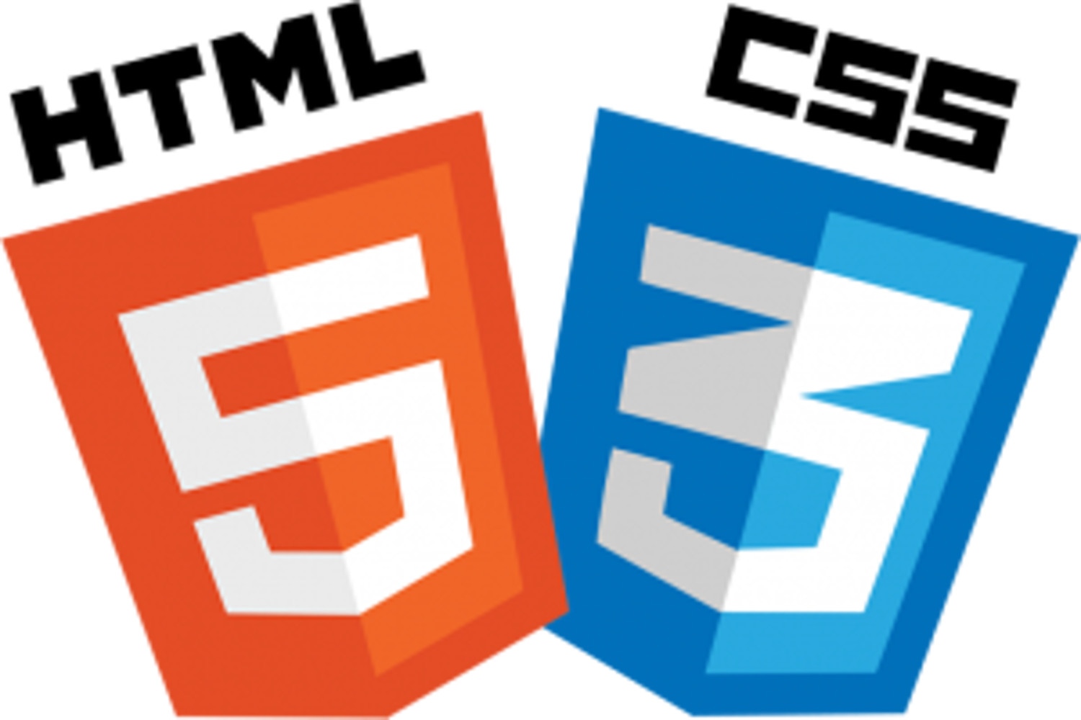








Why R?
Web and Big Data tools
Programming tools
Statistical tools

Slide 5
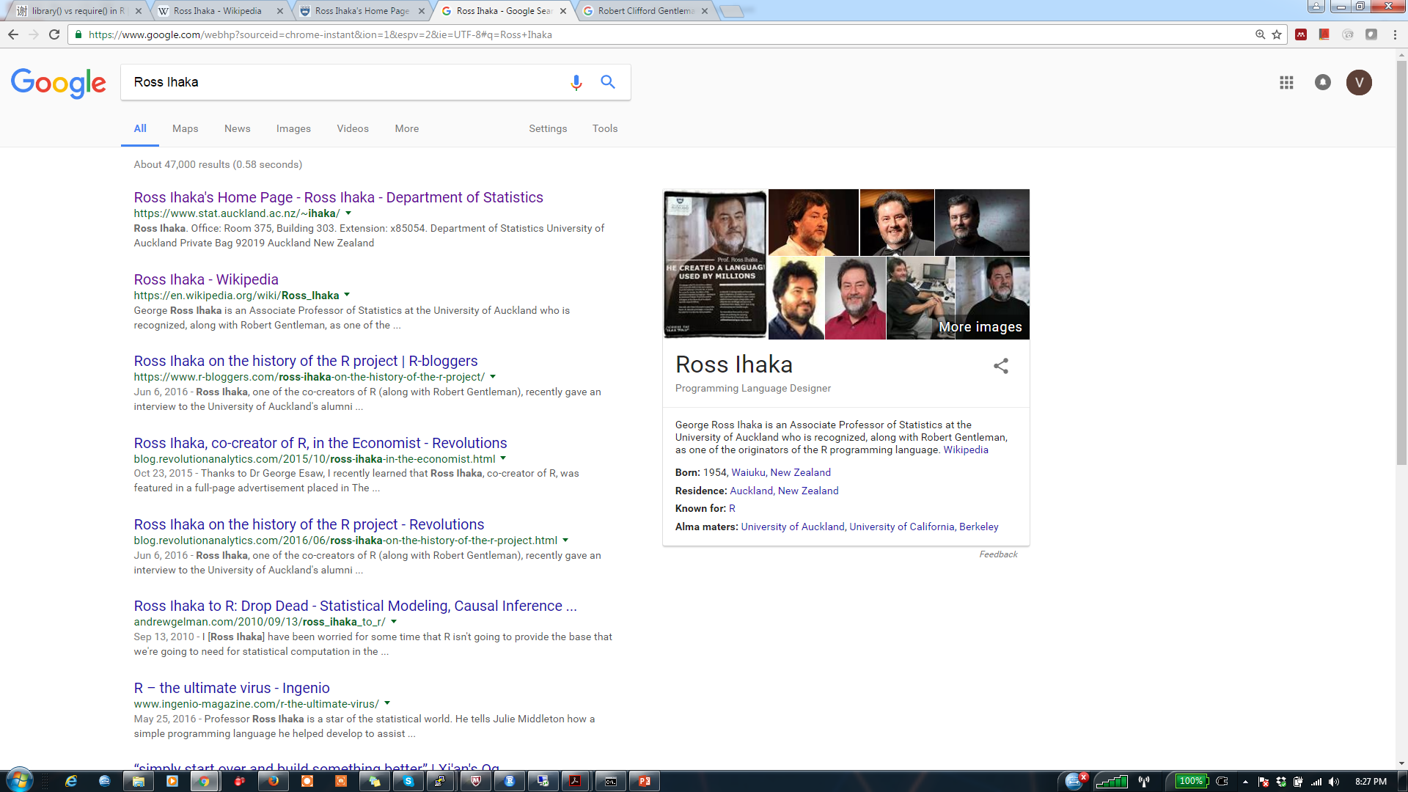
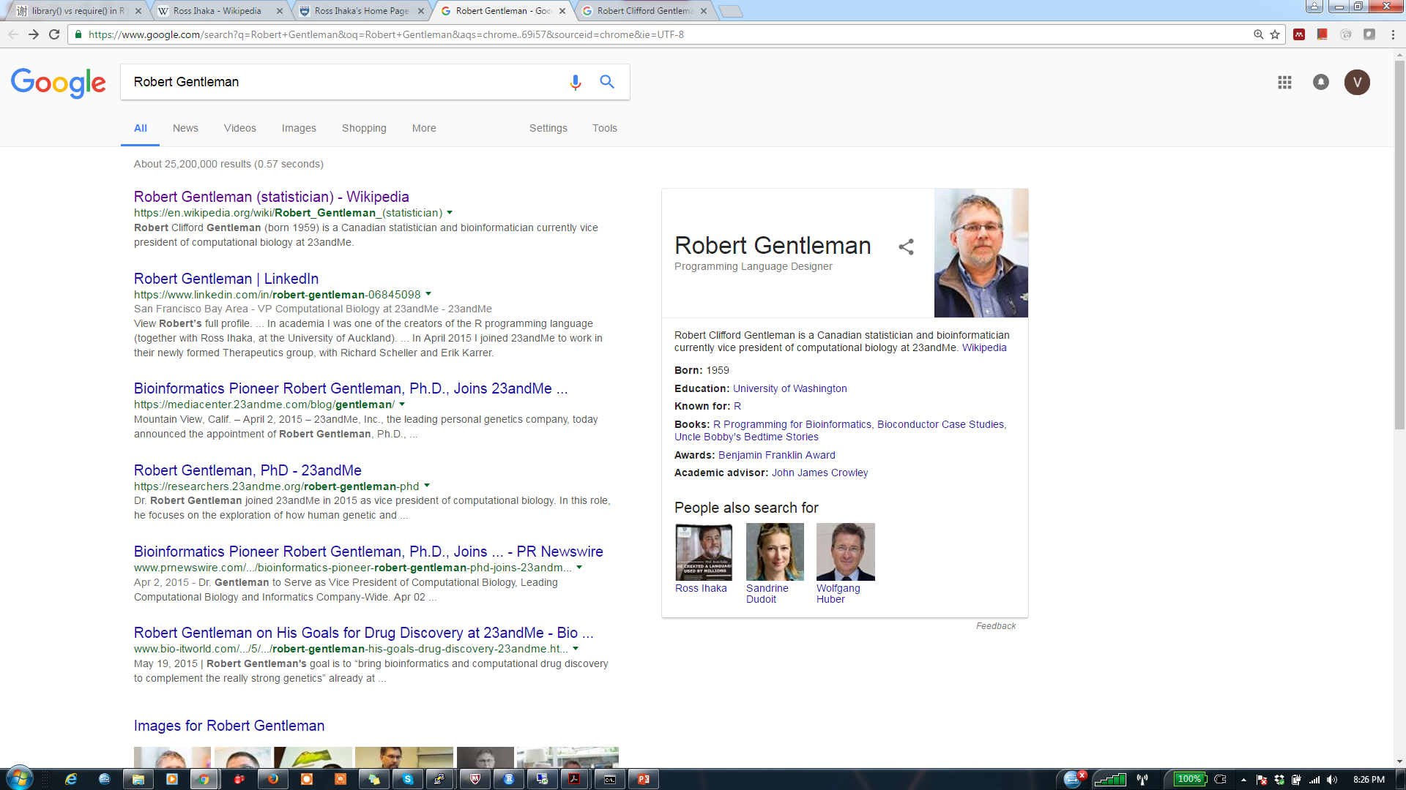
R Programming
Programming environment
Data manipulation
Computation
Statistical analysis
Visualization
Built from S language

Slide 6


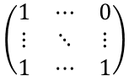
Data Analytics Life Cycle
$$\left(\begin{matrix}1 & ⋯ & 0 \\ ⋮ & ⋱ & ⋮ \\ 1 & ⋯ & 1\end{matrix}\right)$$
Data
Model
R source
code
Model
Evaluation
Development
Deployment

Slide 7

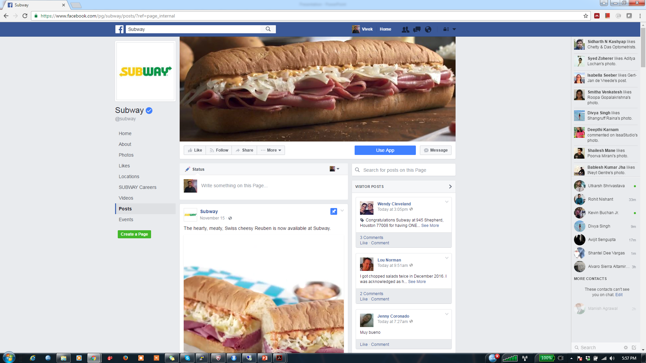

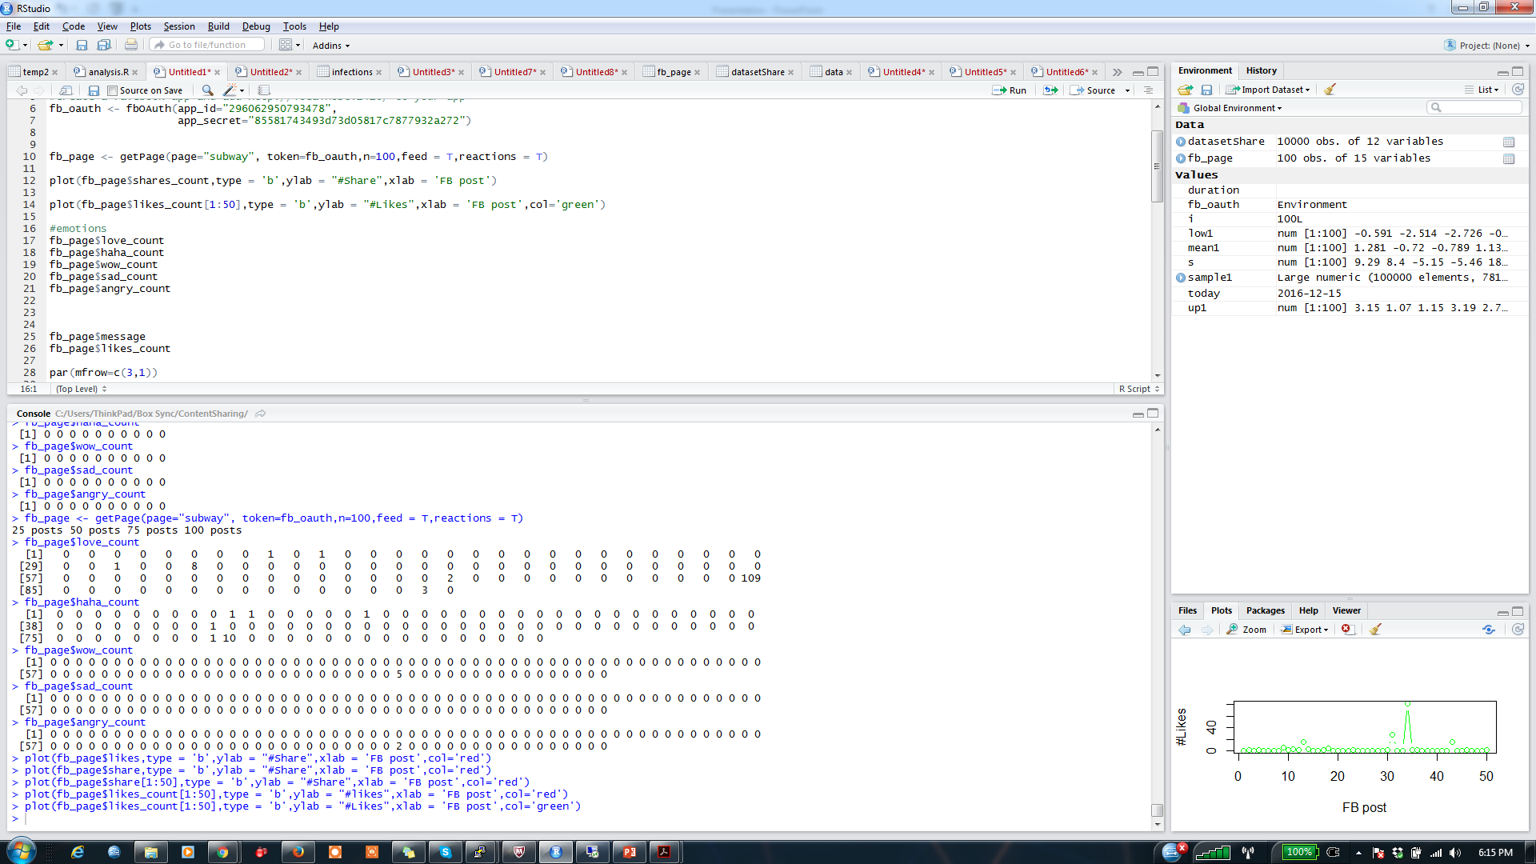
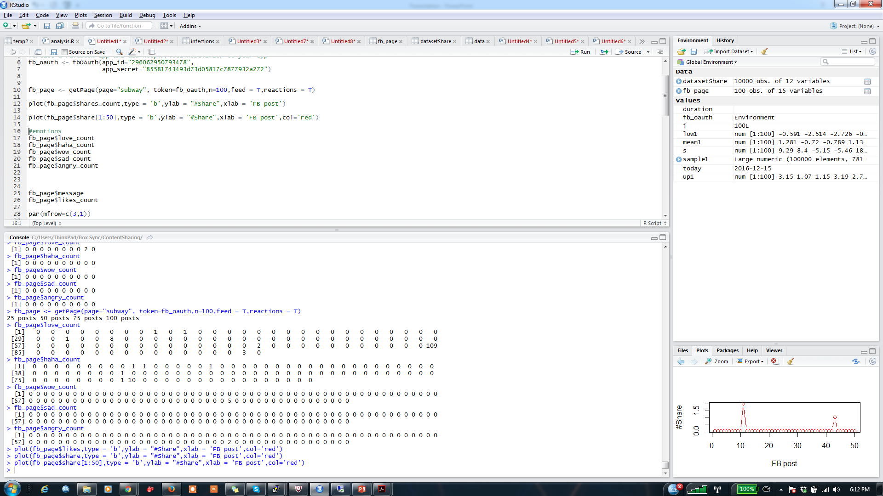
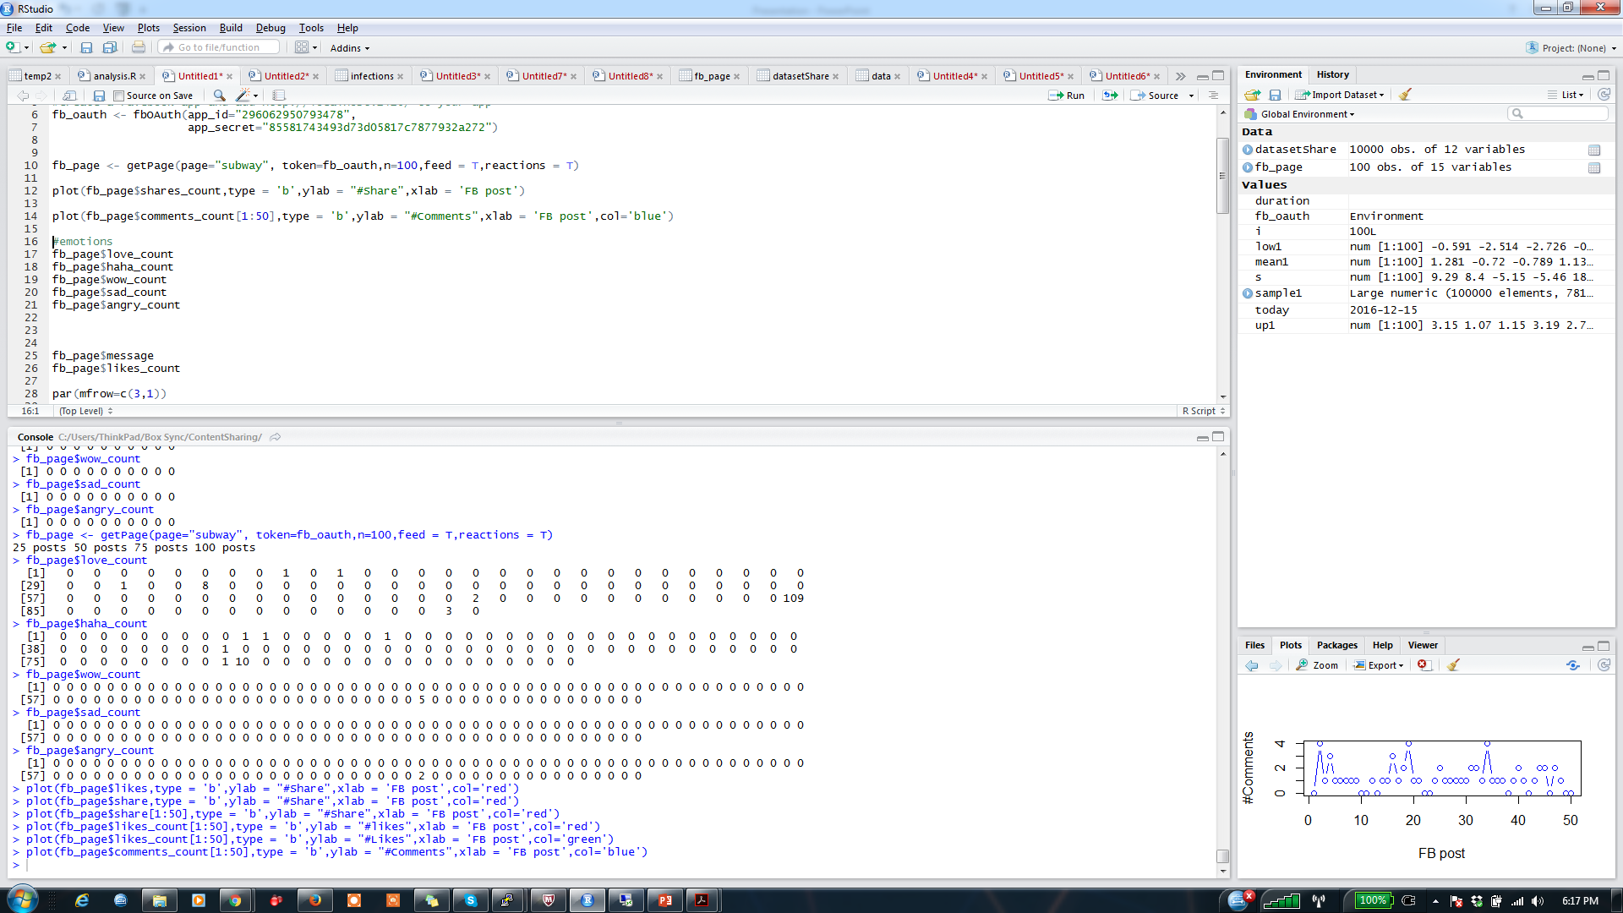
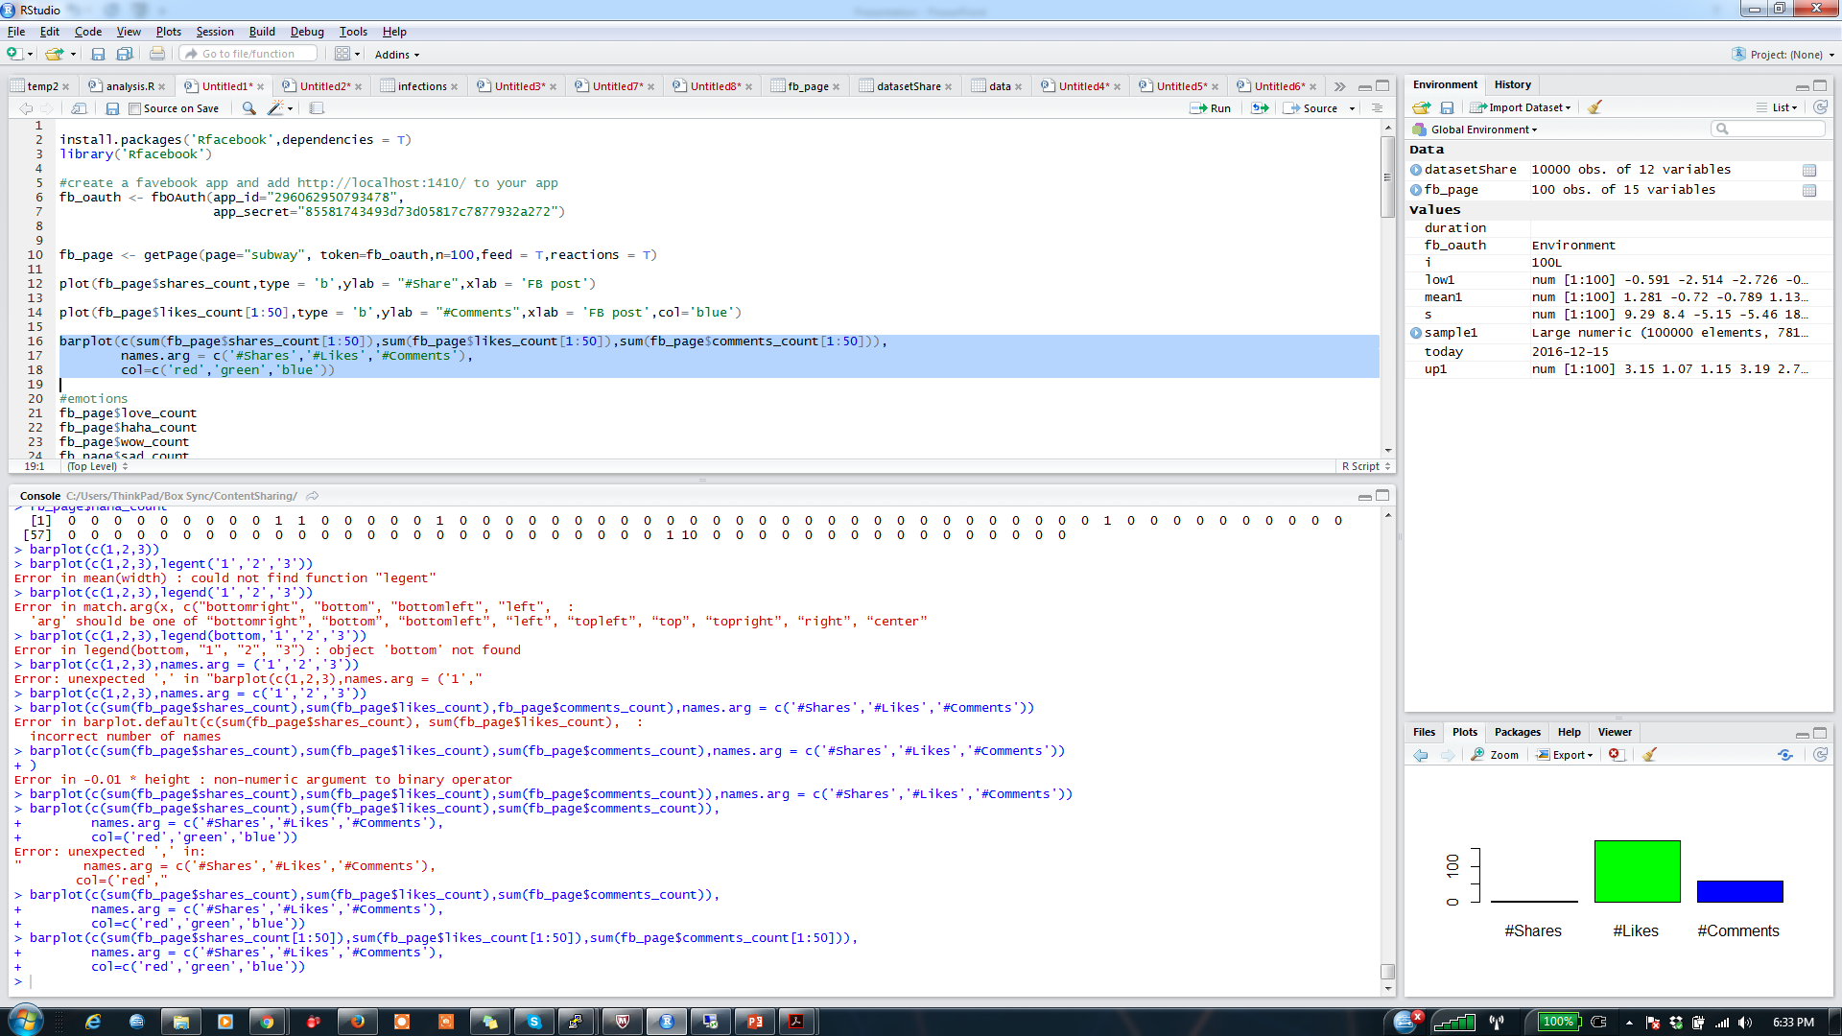
Social Media Analytics Demo with R
DV: #Share | Estimate | Std. Error | t value | Pr(>|t|)
(Intercept) | -0.42 | 0.15 | -2.77 | 0.01 | **
#Likes | 0.12 | 0.01 | 18.88 | < 2e-16 | ***
#Comments | 0.24 | 0.09 | 2.59 | 0.01 | *
(December 16, 2016)

Slide 8
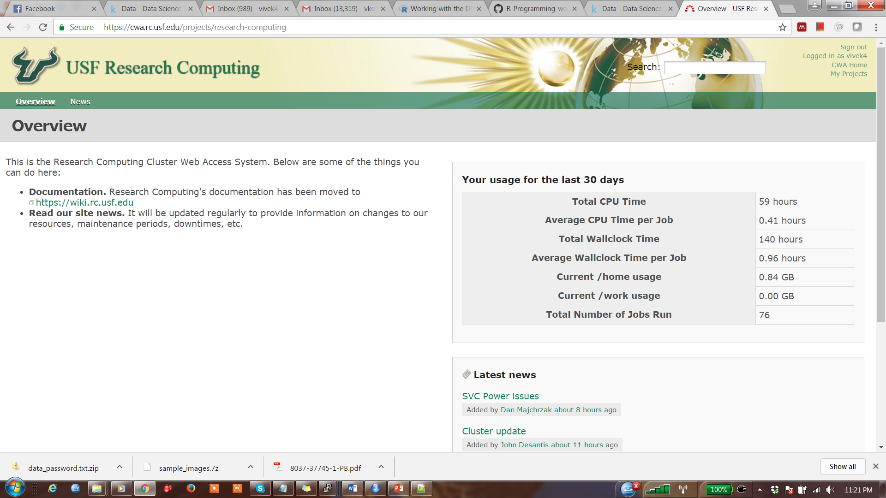
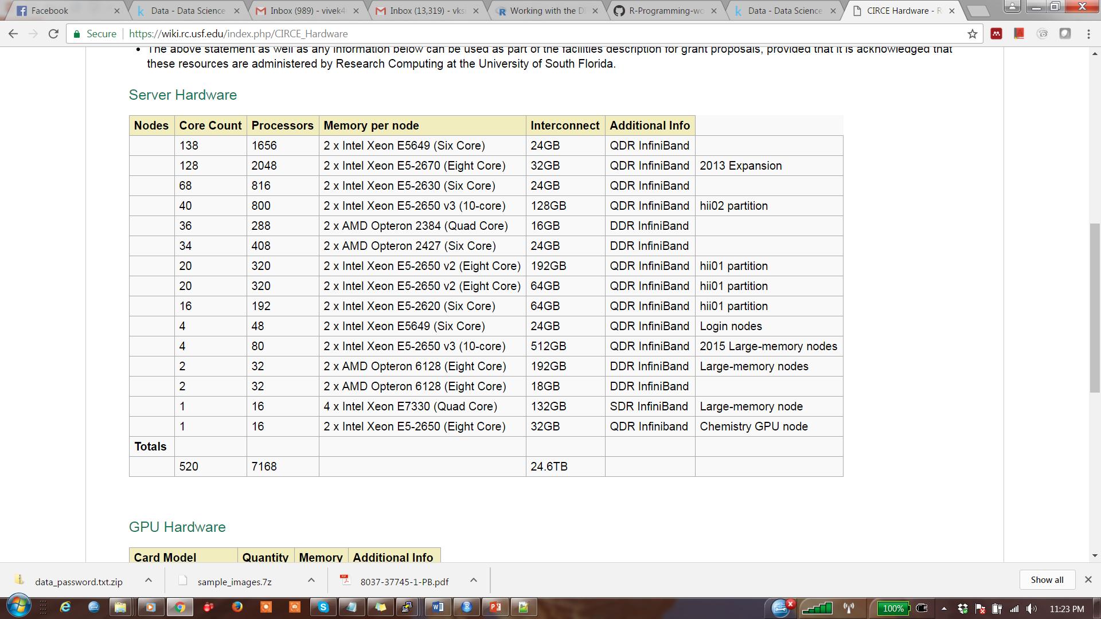
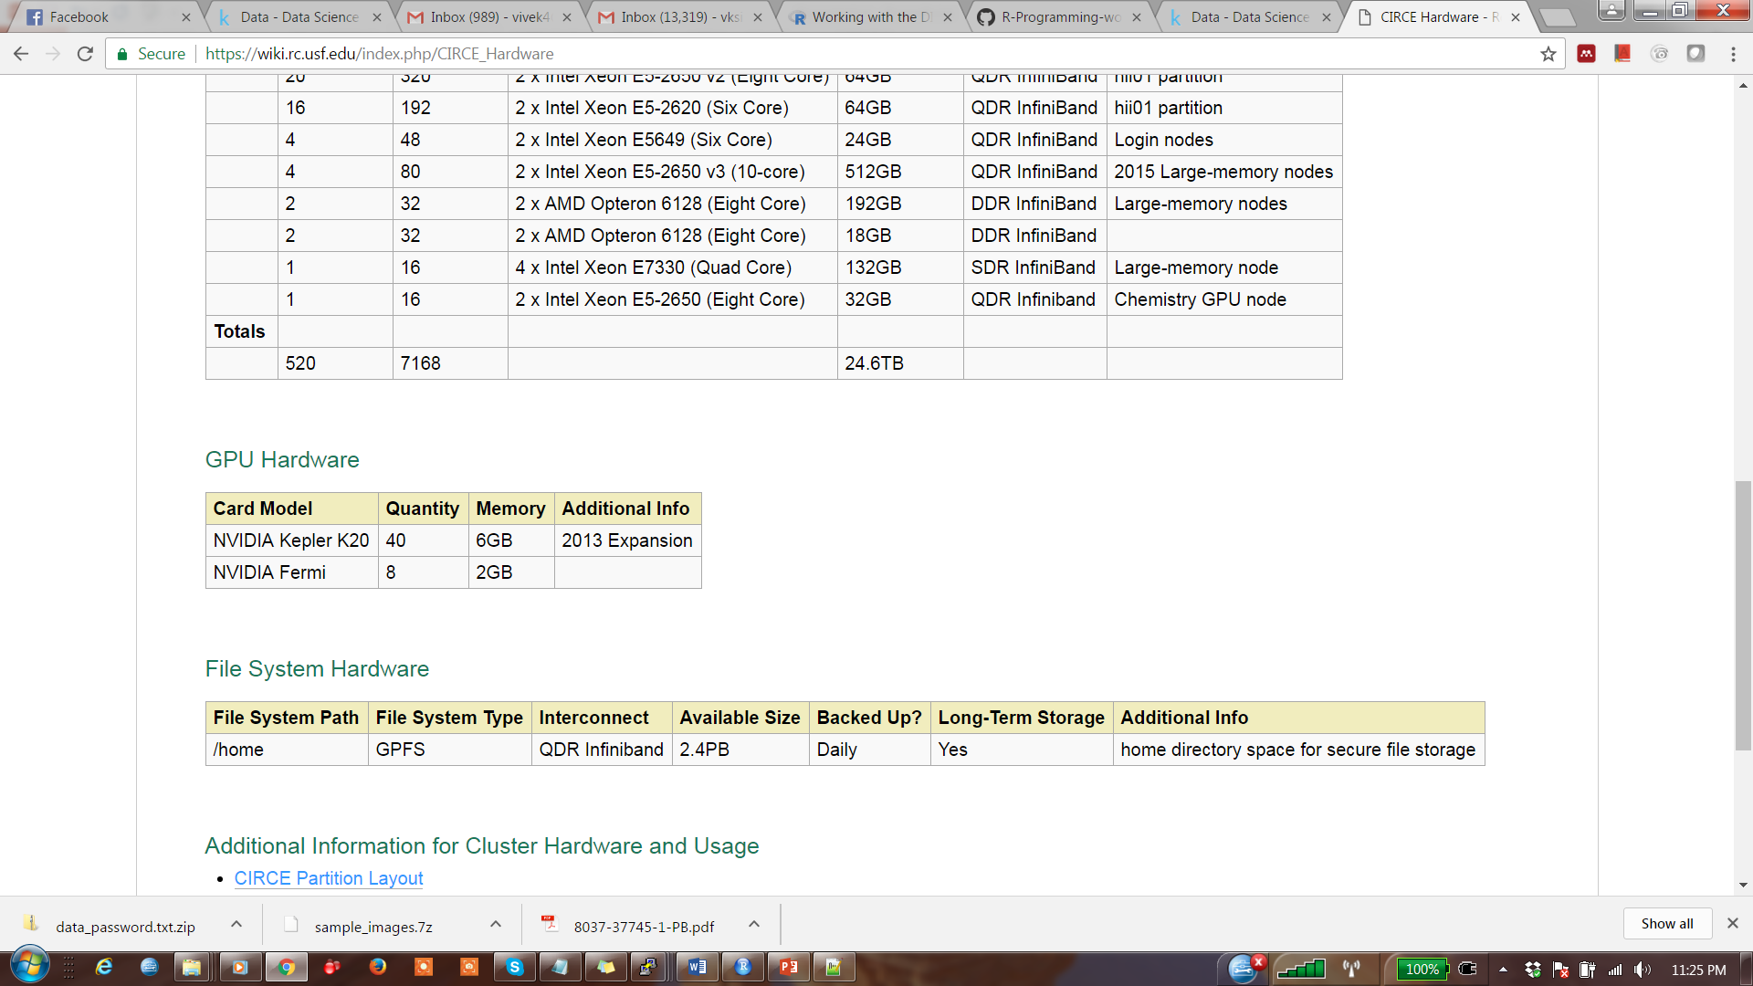

Run R code on CIRCE @USF

Slide 9




Run R code on CIRCE @USF
Source code
version control
Job submission and status check
Email notification
Master node
SLURM environment
Notes:
Image source: http://pd-digital.de/img/patrick_daether_avatar.png

Slide 10
Reference
(Petra Kuhnert and Bill Venables) An Introduction to R Software for Statistical Modelling & Computing, CSIRO Mathematical and Information Sciences Cleveland, Australia
Other books and materials
CRAN project: https://cran.r-project.org/other-docs.html

Slide 11
Outline
Motivation – Why learn R?
Programming IDE – R studio, Workspace, Console
Programming – objects, loops, conditionals, function
File Input/output
R- Packages
Data manipulation
Database connector – MySQL
Visualization
Datasets
Social Media APIs – Twitter, Facebook, Google Trends, Youtube
CIRCE @USF (Cluster Computing)

Slide 12
R studio
Download R-studio desktop
https://www.rstudio.com/products/rstudio/download3/
AGPL license
Windows, Mac OS X, Linux (Ubuntu)

Slide 13
Programming IDE- R Studio
Coding
Execution
Debugging
Batch mode execution
R-workspace
R-working directory

Slide 14
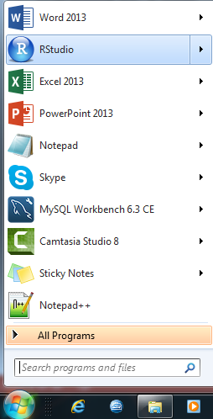
R-studio interface
To quit R, close the R studio
or use q() function if you are using
Command line

Slide 15
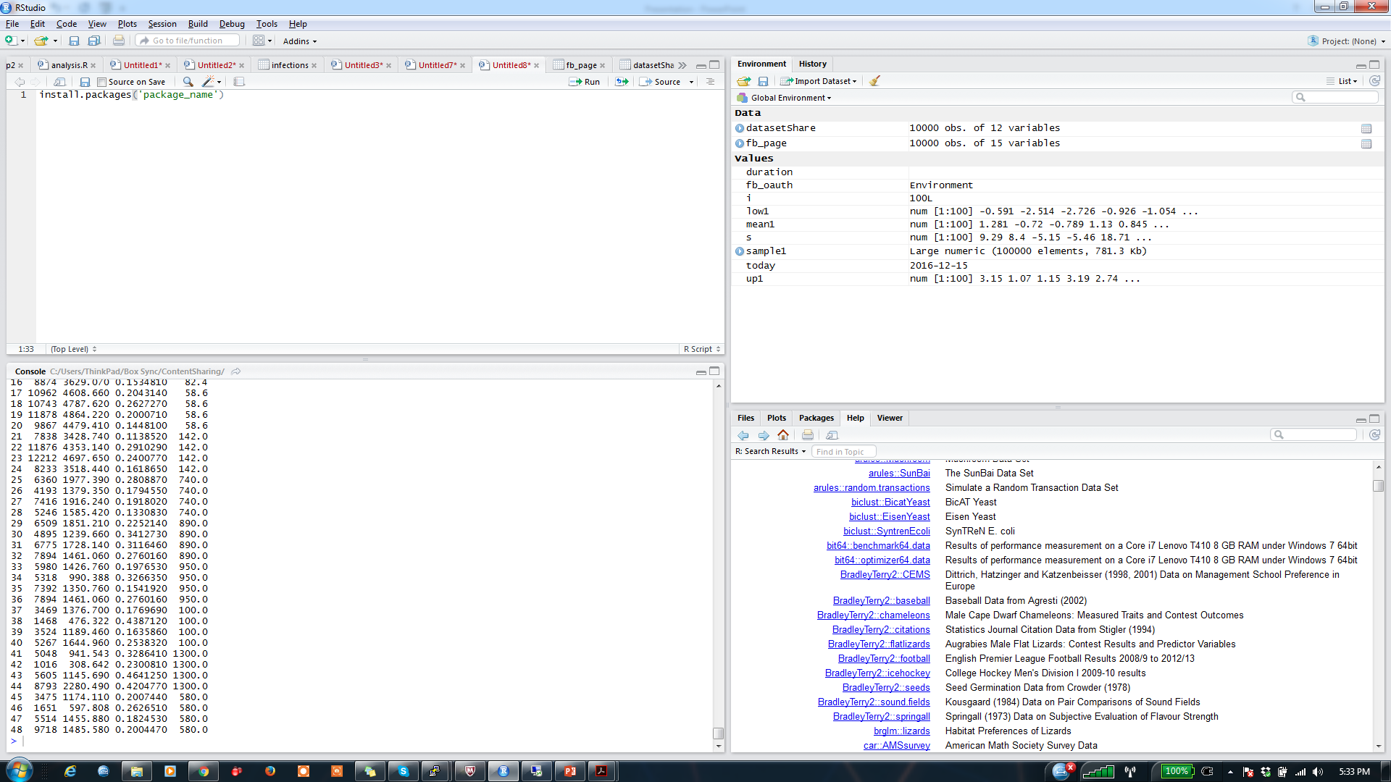
R-studio interface
Code window
Variables window
Execution window
Help/Visualization window

Slide 16
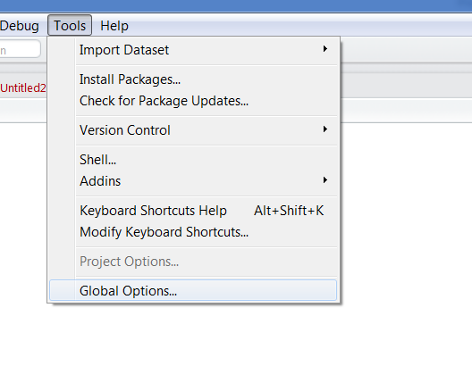
Location of R program
We need to determine
the location of R program
to run batch mode or
command line executing

Slide 17
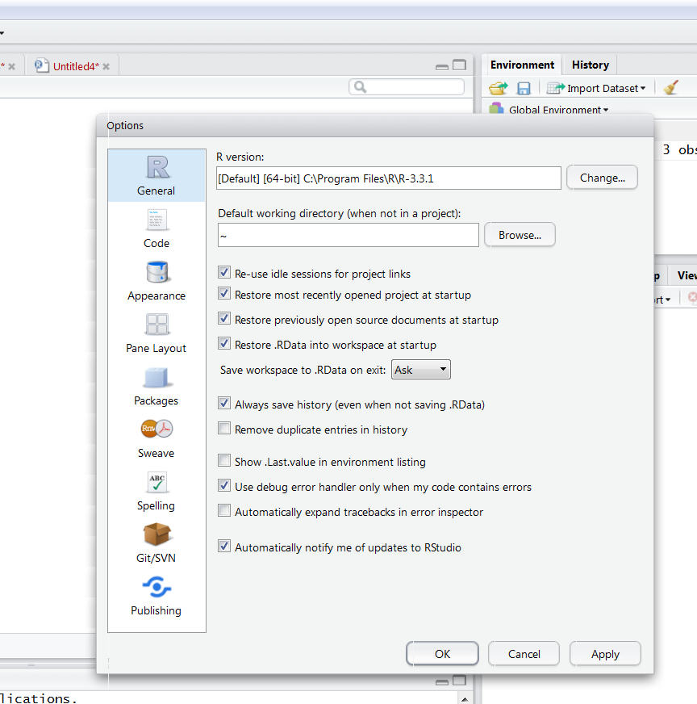
Location of R program

Slide 18
Hello world!!
Method 1:
Write following code in the execution window
>print(‘Hello World’)
Clear console: CTRL+l
Method 2:
Write the code in the code window
Save as ‘script.R’ (optional)
Select the code and click Run button OR (CTRL+ Enter)
Save workspace – save.image(file=‘helloWorld.RData’)
Running from Command prompt: R CMD BATCH script.R

Slide 19
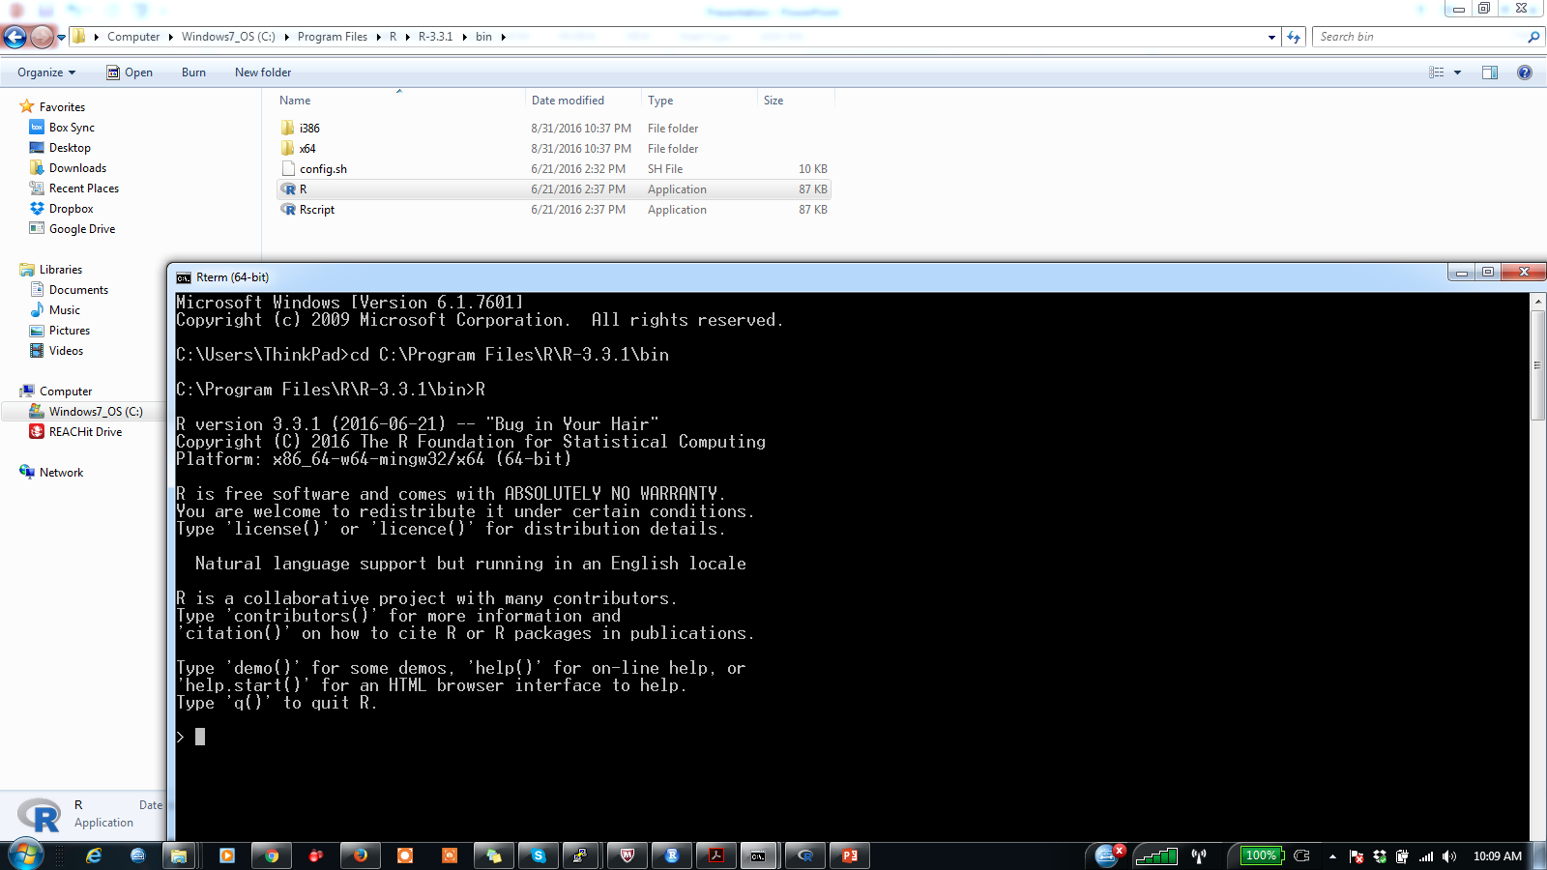
Running R via command Line

Slide 20
Running R via command Line
Why?
Good for automation and running on Clusters such as USF- CIRCE (http://www.usf.edu/it/research-computing/)
Command
"C:\Program Files\R\R-3.3.1\bin\R.exe" CMD BATCH script.R
Creates an output file: script.Rout
Notes:
R version 3.3.1 (2016-06-21) -- "Bug in Your Hair"
Copyright (C) 2016 The R Foundation for Statistical Computing
Platform: x86_64-w64-mingw32/x64 (64-bit)
R is free software and comes with ABSOLUTELY NO WARRANTY.
You are welcome to redistribute it under certain conditions.
Type 'license()' or 'licence()' for distribution details.
Natural language support but running in an English locale
R is a collaborative project with many contributors.
Type 'contributors()' for more information and
'citation()' on how to cite R or R packages in publications.
Type 'demo()' for some demos, 'help()' for on-line help, or
'help.start()' for an HTML browser interface to help.
Type 'q()' to quit R.
> print('hello world')
[1] "hello world"
>
> proc.time()
user system elapsed
0.14 0.01 0.25

Slide 21
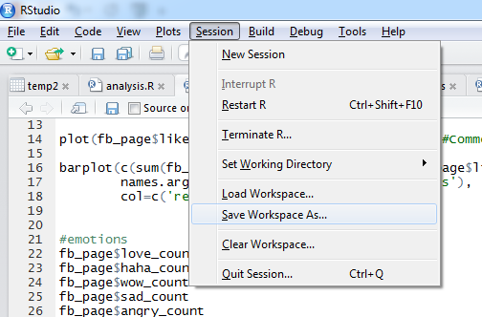
Save R- workspace
save.image("C:/Users/ThinkPad/Box Sync/R workshop/helloworld.RData")
*Keep one workspace for each project

Slide 22
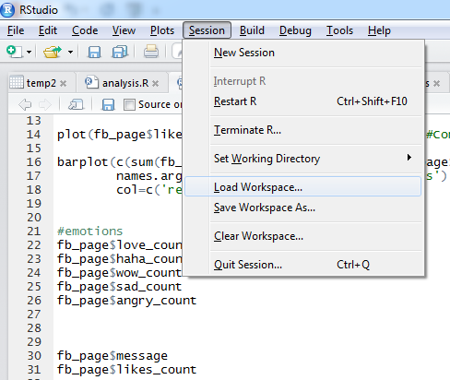
Load R- workspace
load("C:/Users/ThinkPad/Box Sync/R workshop/helloworld.RData")
https://github.com/vivek14632/R-Programming-workshop/blob/master/workspace/workspace.R

Slide 23
Loading Social Media Workspace
Download the Facebook workspace from github: https://github.com/vivek14632/R-Programming-workshop/blob/master/socialMedia/facebook.RData
Load the workspace in R studio
Examine the variables in the workspace ‘fb_page’

Slide 24
R-working directory
Check working directory
getwd()
Set working directory
setwd(‘path_to_directory’)

Slide 25
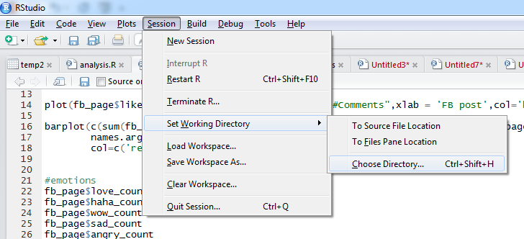
R-working directory
setwd("C:/Users/ThinkPad/Box Sync/R workshop/code")

Slide 26
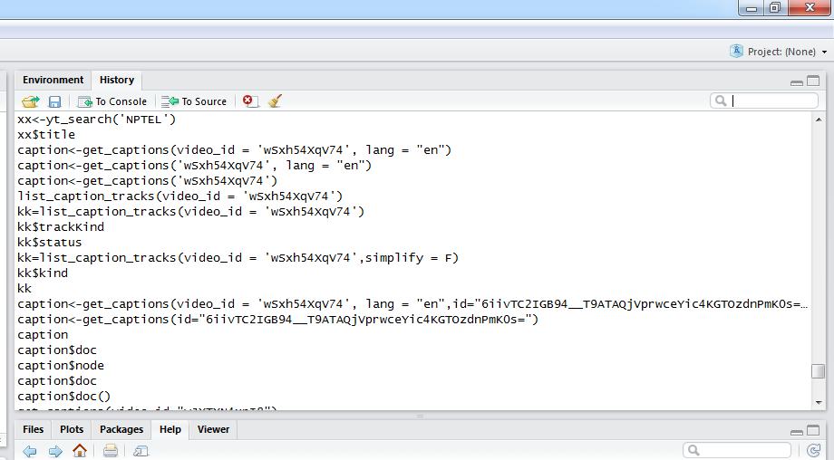
History of commands
history()

Slide 27
Debug R program
print () function
Line by line execution
Breakpoints
Using GUI
browser() function - https://github.com/vivek14632/R-Programming-workshop/blob/master/Debug/browser.R

Slide 28
Outline
Motivation – Why learn R?
Programming IDE – R studio, workspace, Console
Programming – objects, loops, conditionals, function
File Input/output
R- Packages
Data manipulation
Database connector – MySQL
Visualization
Datasets
Social Media APIs – Twitter, Facebook, Google Trends, Youtube
CIRCE @USF (Cluster Computing)

Slide 29
R Objects
Data types: Numeric, Integer, Logical, Complex, Character, Raw
Different types of Objects
Vector
Set of elements of same mode: logical, numeric (integer, double), complex, character, list
Matrix
Rows and columns of same mode: logical, numeric (integer or double), complex or character.
Data frame: Similar to matrix but the columns can be of different modes
List: generalization of vector with a collection of data objects
Class of an Object
Example code: https://github.com/vivek14632/R-Programming-workshop/tree/master/ObjectsInR

Slide 30
Vectors
Different types of vectors
Numeric vectors
Character vectors
Logical vector
Complex vector
https://github.com/vivek14632/R-Programming-workshop/blob/master/ObjectsInR/vectors.R

Slide 31
Vectors
Creating a vector
c() function
seq() function
rep() function
: operator
Creating vector at run-time
Even a single value is a vector
Vector repetition: benefits and challenges
https://github.com/vivek14632/R-Programming-workshop/blob/master/ObjectsInR/vectors.R

Slide 32
Matrix
Converting vector to matrix
dim() function
Creates matrix by column
Can also convert matrix to vector
matrix() function
matrix (vectorName, #rows,#columns)
By row: matrix (vectorName, #rows,#columns, byRow=T)
rbind() function
cbind() function
https://github.com/vivek14632/R-Programming-workshop/blob/master/ObjectsInR/matrix.R

Slide 33
Data Frame
Similar to matrix
Contains data columns with different modes – character, numeric, logical,etc.
Convert matrix to data frame
data.frame()
Columns names: names()
https://github.com/vivek14632/R-Programming-workshop/blob/master/ObjectsInR/dataFrame.R

Slide 34
List
Combination of vector, matrix, data frames with different data types
Used for storing different forms of output and return it from a function
Display the output
https://github.com/vivek14632/R-Programming-workshop/blob/master/ObjectsInR/list.R

Slide 35
Functions
Using library functions
User defined functions
Checking function definitions
Modifying library functions (optional)
Example code: https://github.com/vivek14632/R-Programming-workshop/tree/master/functions

Slide 36
Loops
Different types of loops
For loop
Repeat loop
While loop
‘For’ and ‘While’ loop is most widely used.
https://github.com/vivek14632/R-Programming-workshop/tree/master/loops

Slide 37
Conditionals
If condition
Else condition
Else if condition
Ifelse condition
https://github.com/vivek14632/R-Programming-workshop/blob/master/conditionals/conditionals.R

Slide 38
Outline
Motivation – Why learn R?
Programming IDE – R studio, workspace, Console
Programming – objects, loops, conditionals, function
File Input/output
R- Packages
Data manipulation
Database connector – MySQL
Visualization
Datasets
Social Media APIs – Twitter, Facebook, Google Trends, Youtube
CIRCE @USF (Cluster Computing)

Slide 39
Different file formats
Clipboard
CSV – read and write
JSON format
XLSX format
User inputs via command line
Text file
System directory
Example code: https://github.com/vivek14632/R-Programming-workshop/tree/master/fileIO

Slide 40
Outline
Motivation – Why learn R?
Programming IDE – R studio, workspace, Console
Programming – objects, loops, conditionals, function
File Input/output
R- Packages
Data manipulation
Database connector – MySQL
Visualization
Datasets
Social Media APIs – Twitter, Facebook, Google Trends, Youtube
CIRCE @USF (Cluster Computing)

Slide 41
Packages in R
Installation
Loading
Updating packages
Uninstall packages
Example code:
https://github.com/vivek14632/R-Programming-workshop/blob/master/package/packages.R
Notes:
#Install package
> install.packages('tm',dependencies=T)
Installing package into ‘C:/Users/ThinkPad/Documents/R/win-library/3.3’
(as ‘lib’ is unspecified)
Warning in install.packages :
dependencies ‘Rcampdf’, ‘Rgraphviz’, ‘Rpoppler’, ‘tm.lexicon.GeneralInquirer’ are not available
trying URL 'https://cran.rstudio.com/bin/windows/contrib/3.3/tm_0.6-2.zip'
Content type 'application/zip' length 710795 bytes (694 KB)
downloaded 694 KB
package ‘tm’ successfully unpacked and MD5 sums checked
The downloaded binary packages are in
C:\Users\ThinkPad\AppData\Local\Temp\RtmpeKr76y\downloaded_packages
#Load package
> library('tm')
Loading required package: NLP
Attaching package: ‘NLP’
The following object is masked from ‘package:httr’:
content
Warning message:
package ‘tm’ was built under R version 3.3.2
#remove package
> remove.packages('tm')
Removing package from ‘C:/Users/ThinkPad/Documents/R/win-library/3.3’
(as ‘lib’ is unspecified)
>

Slide 42
Outline
Motivation – Why learn R?
Programming IDE – R studio, workspace, Console
Programming – objects, loops, conditionals, function
File Input/output
R- Packages
Data manipulation
Database connector – MySQL
Visualization
Datasets
Social Media APIs – Twitter, Facebook, Google Trends, Youtube
CIRCE @USF (Cluster Computing)

Slide 43
Data manipulation functions
Table
Subset
Split
Sort
cbind()
rbind()
date and time
apply
Example code: https://github.com/vivek14632/R-Programming-workshop/tree/master/dataManipulation

Slide 44
Outline
Motivation – Why learn R?
Programming IDE – R studio, workspace, Console
Programming – objects, loops, conditionals, function
File Input/output
R- Packages
Data manipulation
Database connector – MySQL
Visualization
Datasets
Social Media APIs – Twitter, Facebook, Google Trends, Youtube
CIRCE @USF (Cluster Computing)

Slide 45
database connection

Slide 46
MySQL database and R
Package: RMySQL
Steps
Install package
Load package
create database connection
execute SQL query
https://github.com/vivek14632/R-Programming-workshop/blob/master/databaseConnection/mysql.R

Slide 47
Outline
Motivation – Why learn R?
Programming IDE – R studio, workspace, Console
Programming – objects, loops, conditionals, function
File Input/output
R- Packages
Data manipulation
Database connector – MySQL
Visualization
Datasets
Social Media APIs – Twitter, Facebook, Google Trends, Youtube
CIRCE @USF (Cluster Computing)

Slide 48
visualization

Slide 49
Visualization
Useful functions for graphs
plot() – frequently used function for plotting
xyplot()
legend() – adding legend
points() – addling points to an existing plot
lines() – adding lines to an existing plot

Slide 50
Plot() basic parameters
type
‘l’ → line
‘p’ → point
‘b’ → both line and point
ylab →“label of Y-axis”
xlab → “label of X-axis”
xlim → range of X-axis
c(lower Value, Upper value)
ylim → “range of Y-axis”
c(lower Value, Upper value)
main → “title of the plot”

Slide 51
Plot() parameters
pch → type of character used in the point plots
lty→ line types
col→ color of lines and points
bty→ type of the box to enclose the graph
lab→ change axis scale
Please check the URL for different forms of points, lines, and colors
http://www.statmethods.net/advgraphs/parameters.html

Slide 52
axis() function
Add axis to an existing plot
side 3
side 2
side 4
side 1

Slide 53
axis() parameters
side → side number to add axis
select one of the values {1,2,3,4}
labels → whether to show label on the axis or not
select one of the values {T,F}
tick → whether to add tick to the axis or not
select one of the values {T,F}
line → distance between label and graph
any real number preferably between [0,1]
pos→ shift position of the axis

Slide 54
legend () function
top left
top
top right
left
right
bottom left
bottom
bottom right

Slide 55
legend() function
legend('topright',c('Minimum price','Maximum Price'),pch = c(1,0),col=c('black','red'),lty = c(2,3))
c('Minimum price','Maximum Price') → variable names

Slide 56
Multiple plots
par(mfrow=c(number of rows,number of columns))
Example: par(mfrow=c(2,3))
Appears by row
par(mfcol=c(number of rows,number of columns))
Appears by columns

Slide 57
Types of plots
Generic Plot or Plot
Density plot
Histogram
Geographical Map
QQ plot
Time series plots
https://github.com/vivek14632/R-Programming-workshop/tree/master/Visualization

Slide 58
Outline
Motivation – Why learn R?
Programming IDE – R studio, workspace, Console
Programming – objects, loops, conditionals, function
File Input/output
R- Packages
Data manipulation
Database connector – MySQL
Visualization
Datasets
Social Media APIs – Twitter, Facebook, Google Trends, Youtube
CIRCE @USF (Cluster Computing)

Slide 59
Datasets

Slide 60
Accessing datasets in R
>install.packages(‘MASS’)
>library(‘MASS’)
#dataset
>quine
Other R dataset packages
datasets
http://stat.ethz.ch/R-manual/R-devel/library/datasets/html/00Index.html
https://github.com/vivek14632/R-Programming-workshop/tree/master/datasets

Slide 61
Outline
Motivation – Why learn R?
Programming IDE – R studio, workspace, Console
Programming – objects, loops, conditionals, function
File Input/output
R- Packages
Data manipulation
Database connector – MySQL
Visualization
Datasets
Social Media APIs – Twitter, Facebook, Google Trends, Youtube
CIRCE @USF (Cluster Computing)

Slide 62
R and Social Media

Slide 63
Social Media APIs
R Packages
Facebook API - Rfacebook
Twitter API - twitterR
Youtube API - tuber
Google Trends API – gtrendsR
Steps
Authentication using Oauth
Use API functions
https://github.com/vivek14632/R-Programming-workshop/tree/master/socialMedia

Slide 64
Outline
Motivation – Why learn R?
Programming IDE – R studio, workspace, Console
Programming – objects, loops, conditionals, function
File Input/output
R- Packages
Data manipulation
Database connector – MySQL
Visualization
Datasets
Social Media APIs – Twitter, Facebook, Google Trends, Youtube
CIRCE @USF (Cluster Computing)

Slide 65
Working with CIRCE
SLURM Job scheduler
R script
Submission script
Important command

Slide 66
Submission script
#!/bin/bash
#
#SBATCH --comment=r-test
#SBATCH --ntasks=4
#SBATCH --job-name=r-test
#SBATCH --output=output.%j.r-test
#SBATCH --time=01:00:00
#### SLURM 4 processor R test to run for 1 hour.
module purge
module add apps/R/3.1.2
mpirun Rmpi test.R

Slide 67
Important commands
sbatch: Submit jobs to SLURM
squeue: Check your job status
scancel: cancel your job
https://github.com/vivek14632/R-Programming-workshop/tree/master/CIRCE

Slide 68
Social Media Demo
Download and load the Facebook workspace from Github: https://github.com/vivek14632/R-Programming-workshop/blob/master/socialMedia/facebook.RData
Execute the code- facebook.R from line number 10: https://github.com/vivek14632/R-Programming-workshop/blob/master/socialMedia/facebook.R

Slide 69
Optional
Distribution
Working with standard distribution such as Normal, Poisson, and Uniform.
Financial data
Quantmod library
https://github.com/vivek14632/R-Programming-workshop/blob/master/qunatitativeTrading/gettingData.R

